Slide 1
ARTIFICIAL INTELLIGENCE
UNIT-1

Slide 2
What is Artificial Intelligence?
"It is a branch of computer science by which we can create intelligent machines which can behave like a human, think like humans, and able to make decisions."
Artificial Intelligence is composed of two words Artificial and Intelligence, where Artificial defines "man-made," and intelligence defines "thinking power", hence AI means "a man-made thinking power.“
It is currently working with a variety of subfields, ranging from general to specific, such as self-driving cars, playing chess, proving theorems, playing music, Painting, etc.

Slide 3
Application of AI
Gaming − AI plays crucial role in strategic games such as chess, poker, tic-tac-toe, etc., where machine can think of large number of possible positions based on heuristic knowledge.
Natural Language Processing − It is possible to interact with the computer that understands natural language spoken by humans.
Expert Systems − There are some applications which integrate machine, software, and special information to impart reasoning and advising. They provide explanation and advice to the users.
Vision Systems − These systems understand, interpret, and comprehend visual input on the computer. For example,
A spying aeroplane takes photographs, which are used to figure out spatial information or map of the areas.
Doctors use clinical expert system to diagnose the patient.
Police use computer software that can recognize the face of criminal with the stored portrait made by forensic artist.

Slide 4
Speech Recognition − Some intelligent systems are capable of hearing and comprehending the language in terms of sentences and their meanings while a human talks to it. It can handle different accents, slang words, noise in the background, change in human’s noise due to cold, etc.
Handwriting Recognition − The handwriting recognition software reads the text written on paper by a pen or on screen by a stylus. It can recognize the shapes of the letters and convert it into editable text.
Intelligent Robots − Robots are able to perform the tasks given by a human. They have sensors to detect physical data from the real world such as light, heat, temperature, movement, sound, bump, and pressure.

Slide 5
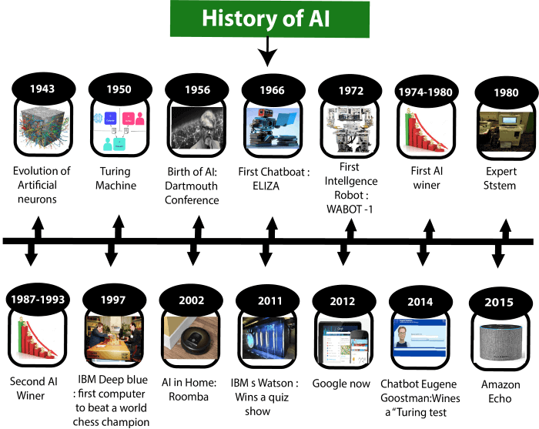
History of Artificial Intelligence

Slide 6
HISTORY
Year 1943: The first work which is now recognized as AI was done by Warren McCulloch and Walter pits in 1943. They proposed a model of artificial neurons.
Year 1949: Donald Hebb demonstrated an updating rule for modifying the connection strength between neurons. His rule is now called Hebbian learning.
Year 1950: The Alan Turing who was an English mathematician and pioneered Machine learning in 1950.
Year 1955: An Allen Newell and Herbert A. Simon created the "first artificial intelligence program"Which was named as "Logic Theorist". ’
Year 1956: The word "Artificial Intelligence" first adopted by American Computer scientist John McCarthy at the Dartmouth Conference. For the first time, AI coined as an academic field.
Year 1966: The researchers emphasized developing algorithms which can solve mathematical problems. Joseph Weizenbaum created the first chatbot in 1966, which was named as ELIZA.
Year 1972: The first intelligent humanoid robot was built in Japan which was named as WABOT-1.

Slide 7
Year 1980: After AI winter duration, AI came back with "Expert System". Expert systems were programmed that emulate the decision-making ability of a human expert.
In the Year 1980, the first national conference of the American Association of Artificial Intelligence was held at Stanford University.
ear 1997: In the year 1997, IBM Deep Blue beats world chess champion, Gary Kasparov, and became the first computer to beat a world chess champion.
Year 2002: for the first time, AI entered the home in the form of Roomba, a vacuum cleaner.
Year 2006: AI came in the Business world till the year 2006. Companies like Facebook, Twitter, and Netflix also started using AI.

Slide 8
Agent and Environments
An agent is anything that can perceive its environment through sensors and acts upon that environment through effectors.
A human agent has sensory organs such as eyes, ears, nose, tongue and skin parallel to the sensors, and other organs such as hands, legs, mouth, for effectors.
A robotic agent replaces cameras and infrared range finders for the sensors, and various motors and actuators for effectors.
A software agent has encoded bit strings as its programs and actions.

Slide 9
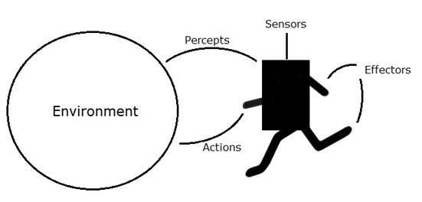
Agent Terminology:
Performance Measure of Agent − It is the criteria, which determines how successful an agent is.
Behavior of Agent − It is the action that agent performs after any given sequence of percepts.
Percept − It is agent’s perceptual inputs at a given instance.
Percept Sequence − It is the history of all that an agent has perceived till date.
Agent Function − It is a map from the precept sequence to an action.

Slide 10
CONCEPT OF RATIONALITY
Rationality is nothing but status of being reasonable, sensible, and having good sense of judgment.
Rationality is concerned with expected actions and results depending upon what the agent has perceived.
Performing actions with the aim of obtaining useful information is an important part of rationality.
Ideal Rational Agent:
An ideal rational agent is the one, which is capable of doing expected actions to maximize its performance measure, on the basis of −
Its percept sequence
Its built-in knowledge base

Slide 11
Rationality of an agent depends on the following :
The performance measures, which determine the degree of success.
Agent’s Percept Sequence till now.
The agent’s prior knowledge about the environment.
The actions that the agent can carry out.

Slide 12
Nature of Environments
The most famous artificial environment is the Turing Test environment,in which one real and other artificial agents are tested on equal ground.
Turing Test:
The success of an intelligent behavior of a system can be measured with Turing Test.
Two persons and a machine to be evaluated participate in the test. Out of the two persons, one plays the role of the tester. Each of them sits in different rooms. The tester is unaware of who is machine and who is a human. He interrogates the questions by typing and sending them to both intelligences, to which he receives typed responses.
This test aims at fooling the tester. If the tester fails to determine machine’s response from the human response, then the machine is said to be intelligent.

Slide 13
Properties of Environment:
Discrete / Continuous − If there are a limited number of distinct, clearly defined, states of the environment, the environment is discrete (For example, chess); otherwise it is continuous (For example, driving).
Observable / Partially Observable − If it is possible to determine the complete state of the environment at each time point from the percepts it is observable; otherwise it is only partially observable.
Static / Dynamic − If the environment does not change while an agent is acting, then it is static; otherwise it is dynamic.
Single agent / Multiple agents − The environment may contain other agents which may be of the same or different kind as that of the agent.
Accessible / Inaccessible − If the agent’s sensory apparatus can have access to the complete state of the environment, then the environment is accessible to that agent.

Slide 14
STRUCTURE OF AGENTS
Agent’s structure can be viewed as −
Agent = Architecture + Agent Program
Architecture = the machinery that an agent executes on.
Agent Program = an implementation of an agent function.

Slide 15
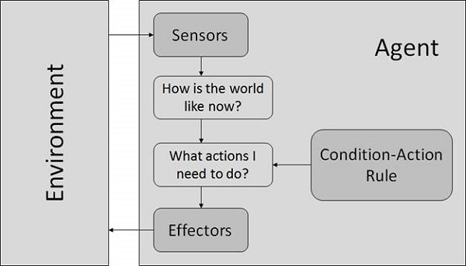
1)Simple Reflex Agents
They choose actions only based on the current percept.
They are rational only if a correct decision is made only on the basis of current precept.
Condition-Action Rule − It is a rule that maps a state (condition) to an action.

Slide 16
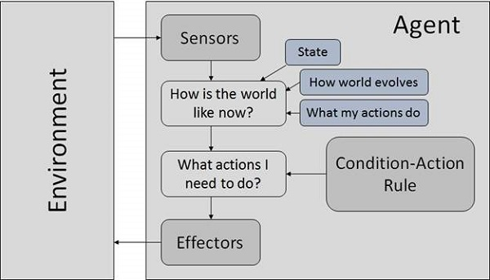
2) Model Based Reflex Agents
They use a model of the world to choose their actions.
Model − knowledge about “how the things happen in the world”.
Internal State − It is a representation of unobserved aspects of current state depending on percept history.

Slide 17
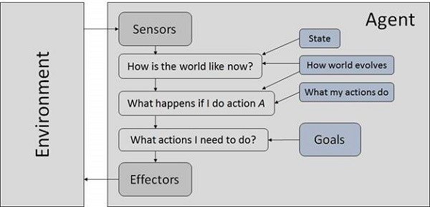
3) Goal Based Agents
They choose their actions in order to achieve goals.
Goal − It is the description of desirable situations.

Slide 18
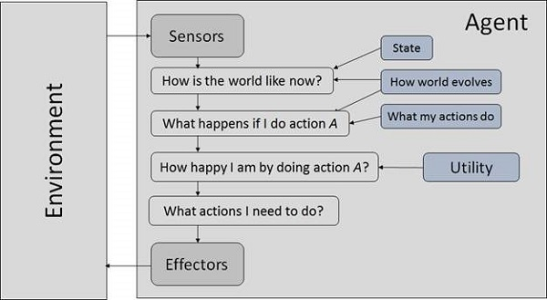
4) Utility Based Agents
They choose actions based on a preference (utility) for each state.

